Slide 1
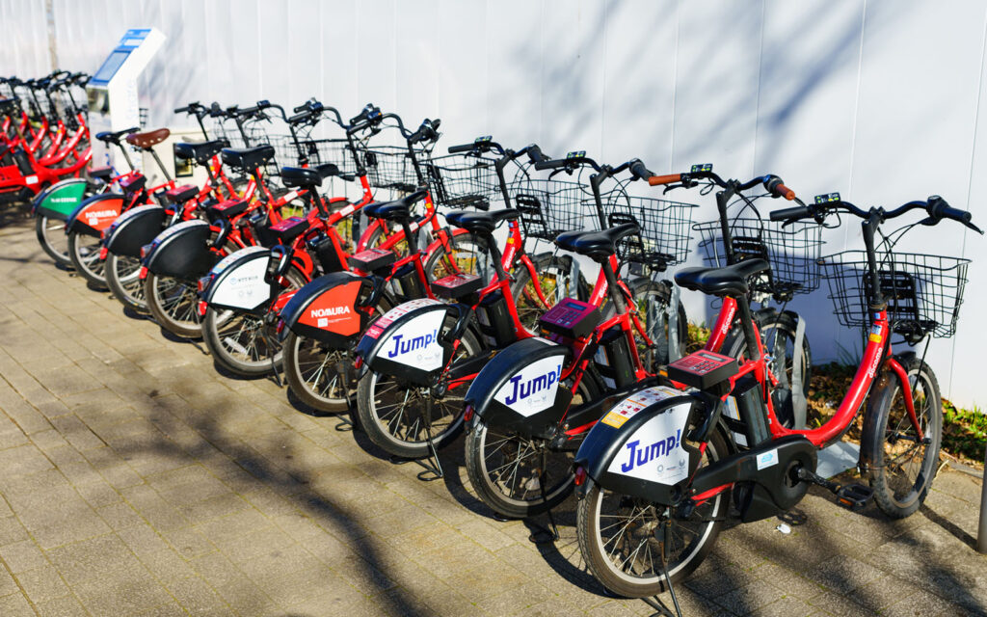
BIKE RENTAL –REGRESSION PROJECT
GROUP :3
TEAM MEMBERS :-
POODI LASYA PRIYA
NAYAN DEELIP SAGARE
MANI MADHURI DEVULAPALLI
YERUVA ANJANEYA REDDY
VANGA KISHORE REDDY
KOTTAGUNDA CHANDRA MOULI GUPTA
ABHIRAJ R

Slide 2

BIKE RENTAL SHARING
Problem Statement:
The business problem is to ensure a stable supply of rental bikes in urban cities by predicting the demand for bikes. By providing a stable supply of rental bikes, the system can enhance mobility comfort for the public and reduce waiting time, leading to greater customer satisfaction and accurately predicting bike demand can help bike sharing companies optimize operations including bike availability, pricing, strategies, and marketing efforts by considering demand Based on various external factors such as weather, season, holiday etc..,
GIVEN DATA: The bike sharing rental data set contains the hourly and daily count of rental bikes between years 2011 and 2012 in capital bike sharing system. With corresponding weather and seasonal information.
Data set contains 17 columns and 17379 rows
Attribute information :
instant : index number
dteday : date (format: YYYY-MM-DD)
season : season name
Yr : year
month : month (1-12)(Jan-dec)
Hr : hour(0 to 23)
holiday : whether the holiday is there or not
Weekday : day of the week
workingday: whether it is a working day or not
weathersit : weather situation
temp : normalized temperature in Celsius
Atemp : normalized feeling temperature
hum : normalized humidity. The values are divided by 100
windspeed : normalized wind speed. Values are divided by 67
casual : count of casual users
registered : number of registered users
cnt : count of total rental biked including both casual and registered

Slide 3
PROJECT WORKFLOW
EXPLORATORY DATA ANALYSIS (EDA)
CHALLENGES
DATA VISUALIZATION
FEATURE ENGINEERING
MODEL BUIDLING
MODEL DEPLOYMENT

Slide 4
EXPLORATORY DATA ANALYSIS
Steps followed in EDA are:
Understanding the structure, columns, and data types.
Metric | temp | atemp | hum | windspeed | casual | registered | cnt
Count | 17,368 | 17,373 | 17,373 | 17,374 | 17,378 | 17,378 | 17,379
Mean | 0.497 | 0.476 | 0.627 | 0.190 | 35.68 | 153.79 | 189.46
Std. Dev. | 0.193 | 0.172 | 0.193 | 0.122 | 49.31 | 151.36 | 181.39
Min | 0.020 | 0.000 | 0.000 | 0.000 | 0.00 | 0.00 | 1.00
25% (Q1) | 0.340 | 0.333 | 0.480 | 0.105 | 4.00 | 34.00 | 40.00
Median (Q2) | 0.500 | 0.485 | 0.630 | 0.194 | 17.00 | 115.00 | 142.00
75% (Q3) | 0.660 | 0.621 | 0.780 | 0.254 | 48.00 | 220.00 | 281.00
Max | 1.000 | 1.000 | 1.000 | 0.851 | 367.00 | 886.00 | 977.00
Key Observations:
temp and atemp:
Mean and median are close, indicating symmetric distributions.
Range is between 0.02 and 1.00.
hum:
Mean is slightly below the median, suggesting a slightly skewed distribution.
Some extreme values (0 and 1) exist.
windspeed:
Small values dominate the range (median = 0.194).
Max value (0.851) indicates some higher windspeeds.
casual, registered, and cnt:
Total rentals (cnt) combines casual and registered users.
High variability in casual and registered usage
(as shown by high standard deviations).

Slide 5
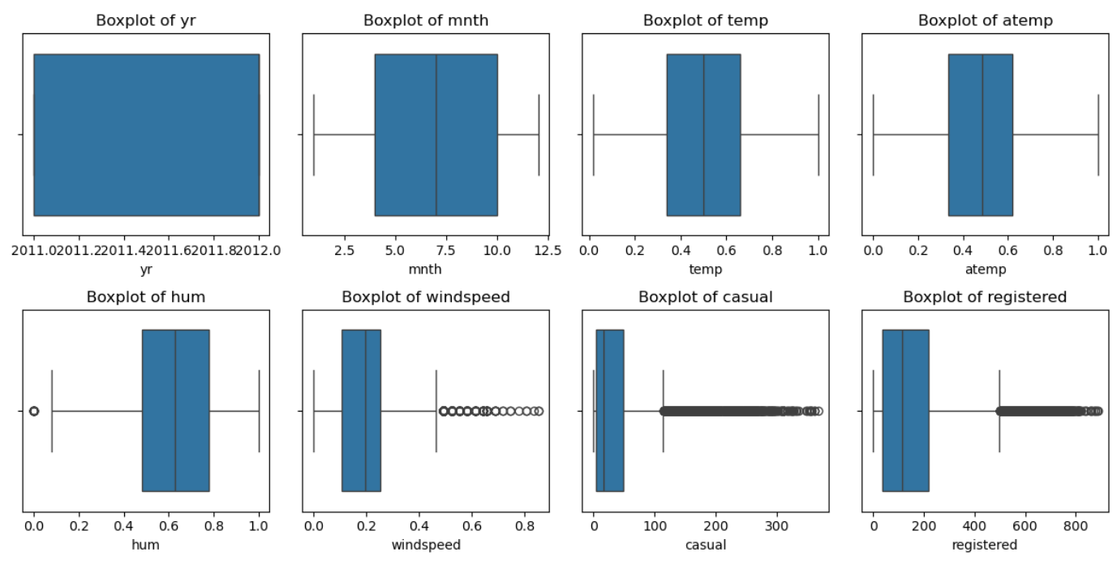
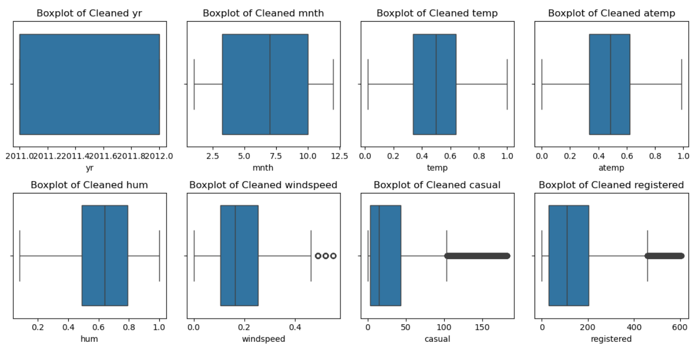
EXPLORATORY DATA ANALYSIS
Steps followed in EDA are:
Data cleaning : by checking for invalid records, missing values, duplicated records, and outliers.
Detecting missing values and apply appropriate imputation techniques
Identifying outliers and decide whether to remove or transform them.
ACTUAL vs CLEANED OUTLIERS DATA USING BOX PLOT

Slide 6
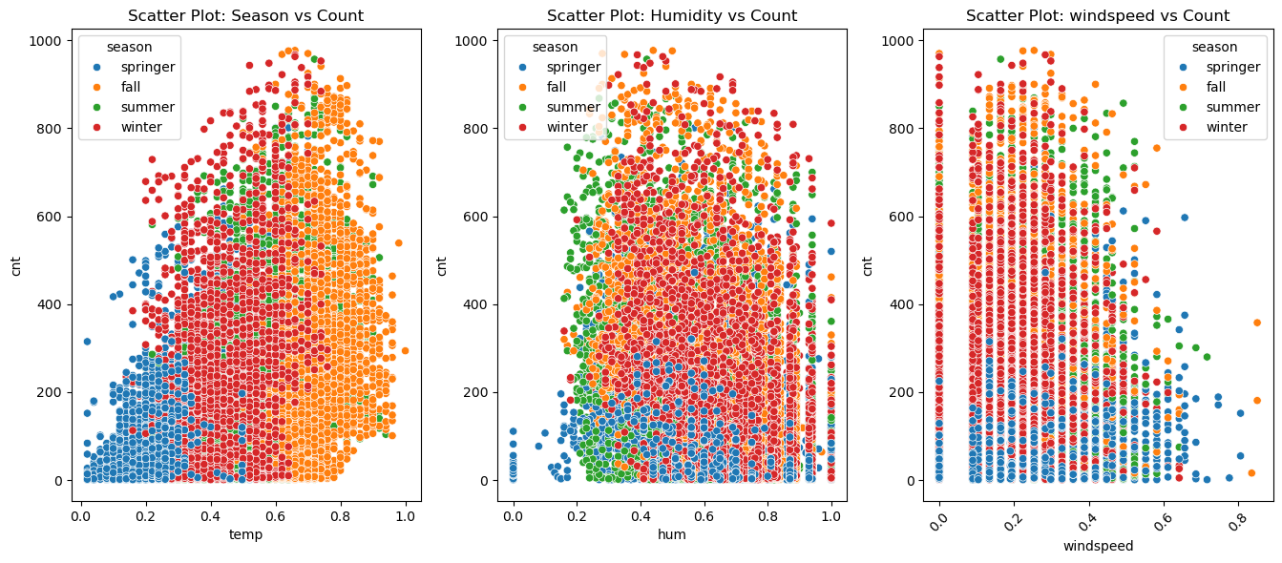
DATA VISUALIZATION
Steps followed for Visualization
Using Seaborn,matplotlib and SciPy, the visualizations such as scatter plots, line plots, and bar plots to explore relationships between variables.
Plotting time series data to analyze trends and seasonality.
Using heatmaps or correlation matrices to understand the correlation between different features.
Utilizing seaborn, matplotlib, or other libraries for generating informative and visually appealing plots.
SCATTER PLOT:
Key Observations
Scatter plots show the relationship between bike rental demand ("cnt") and three variables: temperature, humidity, and windspeed.
temperature vs. count: Higher temperatures (summer and fall) are associated with increased bike rentals, while colder seasons (spring, winter) show lower demand.
Humidity vs. count: Demand is relatively consistent across humidity levels but slightly decreases at extreme values.
Windspeed vs. count: Rentals decline as windspeed increases, with the highest demand in low-wind conditions.
Each plot is color-coded by season, highlighting seasonal trends in demand.

Slide 7
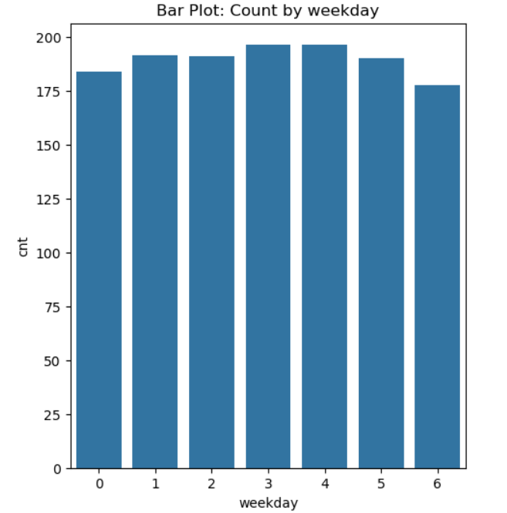
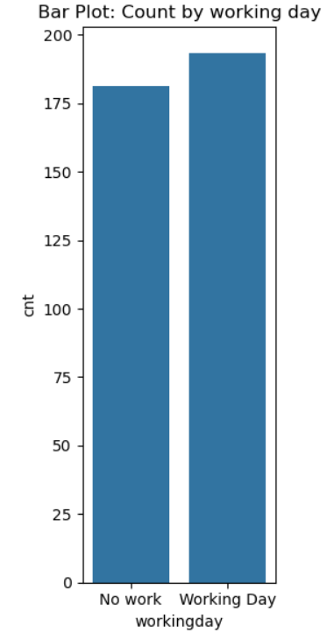
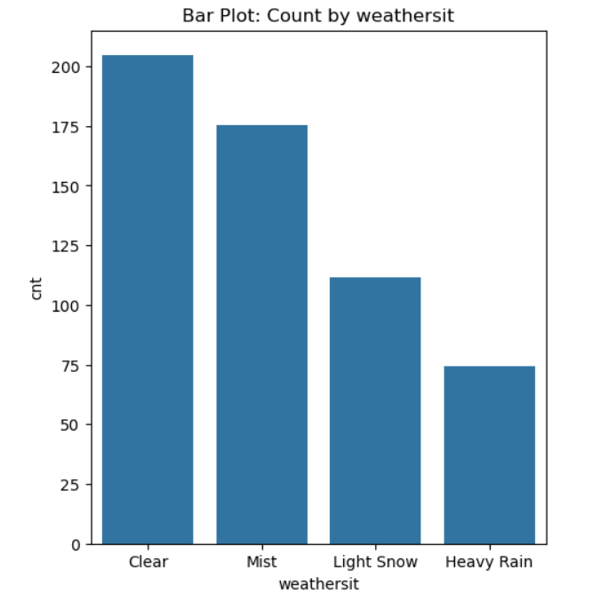
DATA VISUALIZATION
BAR PLOT:
Key Observations:
The rental counts are fairly consistent throughout the week,with minor peaks towards the end of the week.
Trend Insights: This indicates regular usage patterns that are not heavily influenced by the day of the week
Key Observations:
The rental counts are relatively balanced with a slight increase in rentals during working days
Trend Insights: This may indicate regular use of bikes commuting during working days, while leisure activities contribute to steady usage on weekdays or holidays
Key Observations:
The demand for bikes seems to be highest during clear weather or specific seasons(likely spring or summer)
Trend Insights: Warmer or Pleasant seasons see higher bike usage, possibly due to favourable weather conditions for outdoor activities

Slide 8
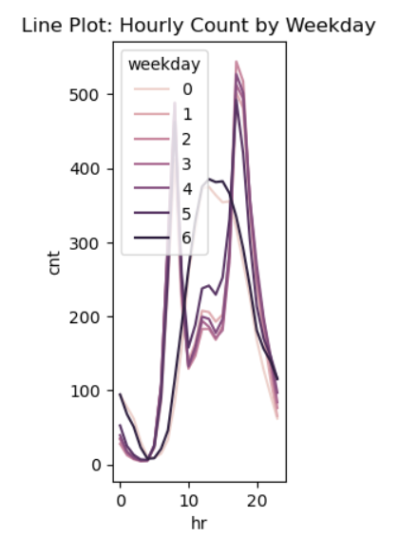
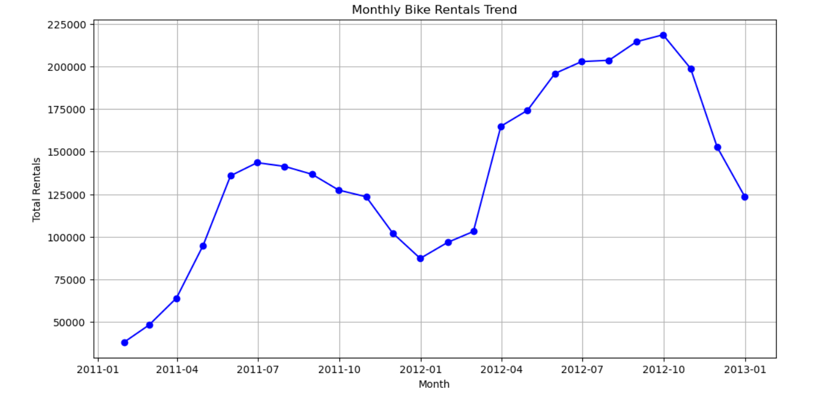
DATA VISUALIZATION
LINE PLOT
TIME SERIES ANALYSIS
Key Observations:
Morning peak: 7am to 9am aligning with morning commutes
Evening Peak : surge is observed between 4pm to 7pm
Midday: A noticeable decline in rentals is seen during midday hours, reflecting standard working hours when bike usage is minimal.
Steady increase: peaking around midday to early afternoon
Evening Decline: a gradual decrease in rentals is observed in the late afternoon and evening hrs
Key Observations:
Summer 2011: a steep rise from Jan to July with rentals peaking at 150000 followed by a gradual decline toward winter
2012 Trend : A similar pattern with even higher rentals compared to 2011,peaking at over 200000 rentals in the summer
End of 2012: A sharp drop in the last month of the year coinciding with the onset of winter.
Peaks during summer months and dips during the winter months, pattern is seen in both the years

Slide 9
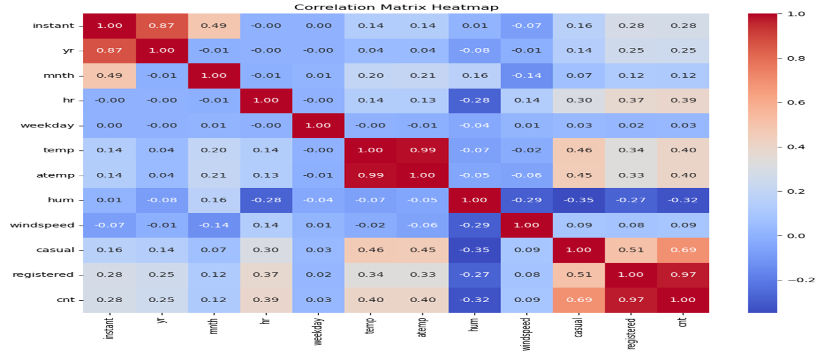
DATA VISUALIZATION
CORRELATION USING HEATMAP
We use the correlation matrix for numerical data
We observe a highly positive correlation between ‘temp’ and ‘atemp’ and between ‘casual’ and ‘registered’

Slide 10
Feature engineering
Feature Generation:
temp_squared: Square of the temp column (after converting to numeric and handling missing values).
humidity_windspeed_interaction: Interaction term between hum and windspeed.
Handling Categorical Variables:
One-Hot Encoding: Converts categorical columns (season, weekday, weathersit) into binary dummy variables, dropping the first category to avoid multicollinearity.
Scaling Numerical Features:
Converts selected numerical columns to numeric (handling errors).
Drops rows with missing values in these columns.
Applies StandardScaler to standardize the selected numerical columns, ensuring mean of 0 and a standard deviation of 1.
Datetime and Derived Features:
Date Parsing: Converts dteday to datetime format and extracts the weekday.
Peak Hour Indicator: Marks rows as peak hours based on the hour (hr).
Weekend Indicator: Marks whether the day is a weekend (Saturday/Sunday).
Temperature Category: Classifies temp into "cold", "moderate", or "hot" categories.
Daytime/Nighttime Indicator: Marks whether the time falls within daytime (6 AM - 6 PM).
Comfort Level: Categorizes comfort based on hum (humidity) and windspeed

Slide 11
Model building
Data Preprocessing:
Converts certain columns (temp, atemp, hum, windspeed) to numeric values using pd.to_numeric() with errors='coerce' to handle invalid values.
One-hot encodes categorical columns (season, yr, mnth, holiday, workingday, weathersit) using pd.get_dummies().
Feature Selection:
The features (X) are selected by dropping the target column (cnt) and other non-relevant columns (instant, dteday, casual, registered).
The target variable (y) is the cnt column.
Model Training:
The dataset is split into training and testing sets using train_test_split.
Three models are initialized: Decision Tree, Random Forest, and Gradient Boosting.
For each model, the code calculates the RMSE, MAE, and R2 values for performance evaluation.
Model Tuning:
For the Decision Tree, Grid Search is used to find the best hyperparameters (max_depth, min_samples_split, min_samples_leaf).
For Random Forest, a similar grid search is used for hyperparameter tuning (n_estimators, bootstrap).
For Gradient Boosting, Randomized Search is used to search over several parameter values (n_estimators, learning_rate, max_depth).
Model Evaluation:
The models are trained and evaluated based on performance metrics: RMSE, MAE, and R2.
Predicted vs Actual values for each model are plotted using scatter plots to visually assess how well the models are performing.
Final Model Tuning and Evaluation:
The best hyperparameters found through the grid or randomized search are used to train the models again.
The models are then evaluated and compared on performance metrics again.

Slide 12
predictions
MODELS | MEAN SQUARED ERROR VALUE | MEAN ABSOLUTE ERROR VALUE | R-SQUARED VALUE
DECISION TREE | RMSE: 0.02332267286701581 | MAE: 0.01561829821505223 | R: 0.9841134884309944
RANDOM FOREST | RMSE: 0.015477182344784238 | MAE: 0.010428325720859773 | R: 0.9930039049630178
GRADIENT BOOSTING REGRESSION | RMSE: 0.11320918760799087 | MAE: 0.08810148899896313 | R: 0.6256867077114533
Key Observations
Based on the performance of models like Random forest Regressor , Decision Tree and Gradient Boosting Regressor
Random Forest Model yeilds the best Results ,99% of the variability in the target variable is explained by the model

Slide 13
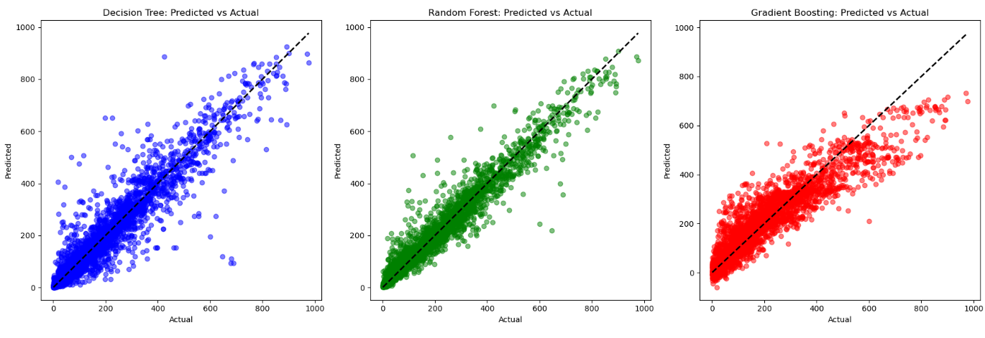
MODEL BUILDING GRAPHS FOR RANDOM FOREST,DECISION TREE,GRADIENTBOOTING REGRESSOR

Slide 14
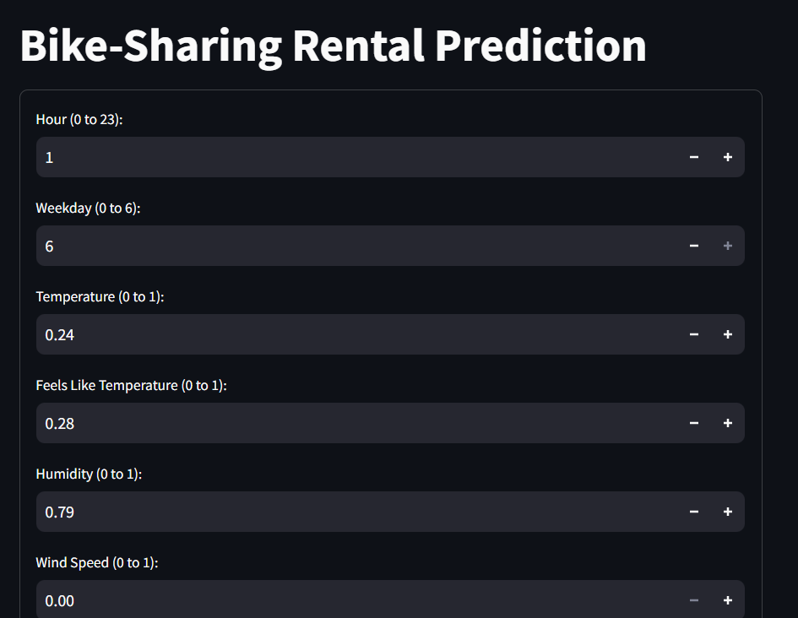
MODEL DEPLOYMENT
Model deployment is the process of integrating a trained machine learning model into a production environment so it can make real-time predictions or automate decision-making.

Slide 15
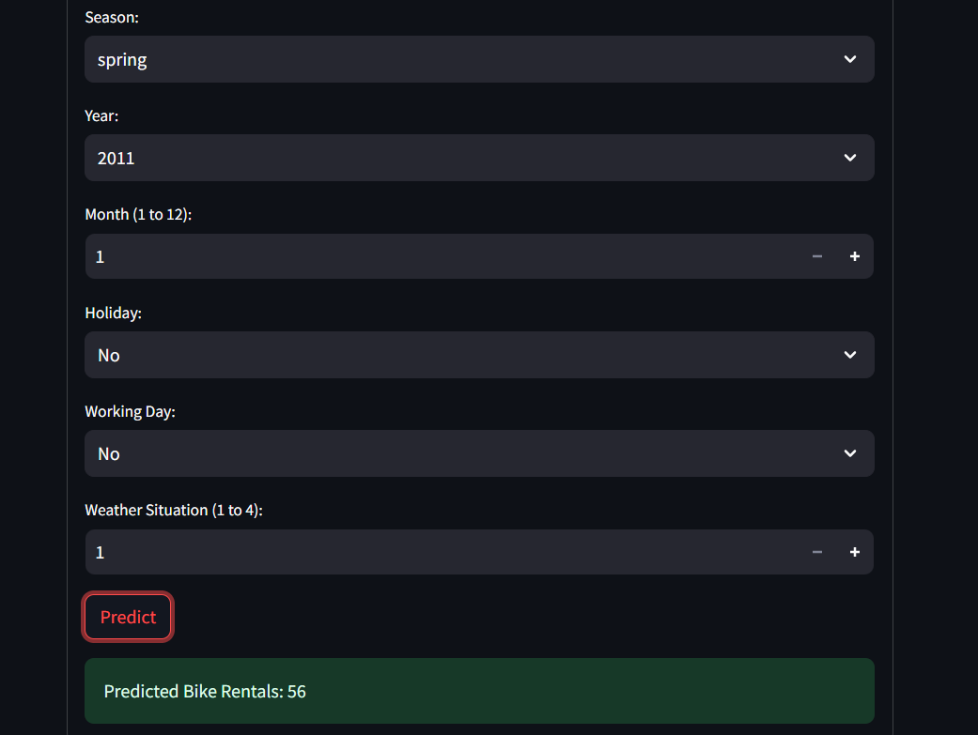
MODEL DEPLOYMENT

Slide 16
CHALLENGES
Data Quality:
There seems to be missing or unclear data, as evidenced by the "?" in the dataset.
Ensuring data consistency and handling missing values would be a challenge.
Feature Engineering:
The analysis involves multiple features such as date, time, weather, and other factors. Creating meaningful features from this raw data would be challenging.
Model Selection:
The analysis compares multiple regression models (Linear Regression, Ridge, Decision Tree, Gradient Boosting, and Random Forest). Choosing the most appropriate model for this specific problem is challenging.
Model Performance:
While the Random Forest Regressor performed best, there's still room for improvement. The challenge lies in further enhancing model accuracy
Handling Time Series Data:
The dataset includes time-based information (date, hour). Properly incorporating time-series aspects into the analysis is challenging.
Dealing with External Factors:
The dataset includes factors like weather and holidays. Understanding and quantifying the impact of these external factors on bike rentals is challenging.
.

Slide 17
CHALLENGES
Interpretability vs. Performance:
While complex models like Random Forest performed better, they are less interpretable than simpler models like Linear Regression. Balancing interpretability with performance is a challenge.
Handling Categorical Variables:
The dataset includes categorical variables like 'season' and 'weathersit'. Properly encoding these variables for machine learning models is a challenge.
Scalability:
With 17,379 entries and 17 columns, ensuring that the analysis and models can scale to larger datasets in the future could be a challenge.

Slide 18
THANK YOU

